Slide 1
THE INTERVIEW continued
It is imperative for oral historians to record the interviewee’s historical narrative. This interview is about them, not you.
Memory is an interesting thing, it can be influenced by emotion, time, etc. However, this interview is about their memories. In this regard, do not correct an interviewee or provide your knowledge of an event.
It’s OK for a veteran to “pass” on questions or subjects.
Don’t ask questions in a way that the best answer is a “yes” or a “no”.
You can ask them to “expand on that” or something similar.
Pauses are OK too, give them time to remember, collect thoughts, etc.

Slide 2
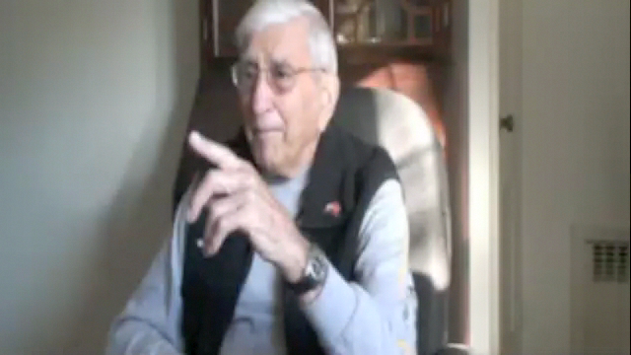
Capitalize on the moment! You have freedom to ask the veteran to expand on something, or to ask your own questions about a subject that the veteran is very excited to talk about. “React to the story rather than the script”.

Slide 3
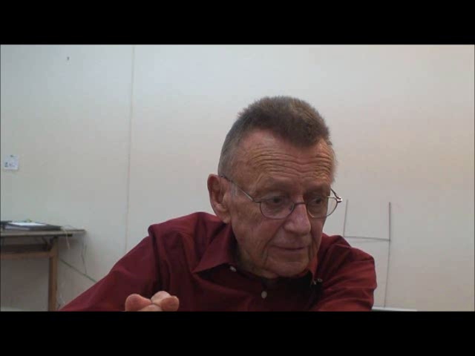
Let the veteran tell their story….

Slide 4
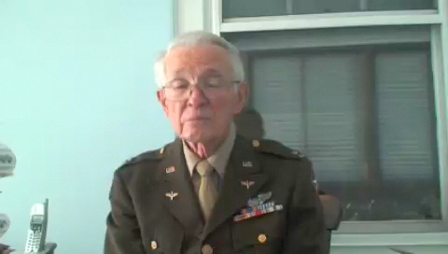
It’s not a conversation.

Slide 5
THE INTERVIEW continued
The most common place veterans may get emotional is when talking about combat or about home.
  You can turn the camera off if they need a break, allow them time to re-group, then continue.
Veterans should know we do NOT edit the footage, you should tell them this.
Although we want veterans to expound upon their stories of service, there may be subjects that they begin to talk about that are off topic (common topics – politics, the “younger generation”) You can guide them back on topic with your questions.

Slide 6
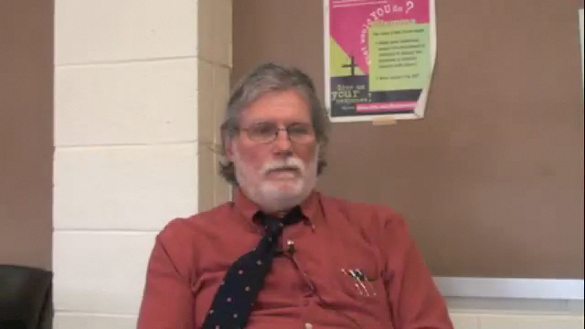
This is an opportunity for even an inexperienced oral historian to capture remarkable stories!

Slide 7
Post-interview

Slide 8
POST-INTERVIEW
Always thank the veteran for their service and for the interview!
Remind them you will send them a copy of the interview.
If they seem like someone who would be a good, dynamic speaker/storyteller, ask them if they would be willing to fill out the Speaker’s Bureau Form.
If they have any artifacts they would like to give you, they have to give the originals. Things like letters, photos, other written material, 2D artwork, etc. We do not take uniforms, dog tags, other large artifacts. They will not get the items back! There are rules associated with these types of artifacts:
  20 pages is the minimum number of pages required for memoirs, diaries or journals
  10 is the minimum number of photographs, letters, maps or pieces of artwork and the minimum number of pages required for military documents

Slide 9
POST-INTERVIEW continued
Once the interview is complete, and you return to campus, please return the AV equipment as soon as possible to VAMP so others can use it.
Begin the transcription process using the Audio and Video Recording Log form, or, if you prefer, in the same format but typed.
VAMP will work with you to be sure that the video is saved in the right format, that at least 3 DVDs are made, and that all documents needed for the package are filled out.
VAMP will send the completed package to the Library of Congress via commercial carrier (never mailed USPS)

Slide 10
Questions?

