Slide 1
Veterans history Project at the university of Connecticut
TRAINING FOR INTERVIEWERS

Slide 2
AGENDA FOR TODAY’S TRAINING
PREPARATION (PART 1)
FORMS
PREPARATION (PART 2)
THE INTERVIEW
POST-INTERVIEW

Slide 3
Preparation (Part 1)

Slide 4
PREPARING FOR THE INTERVIEW
All interviewers must be trained by the VAMP Office prior to conducting any interviews.
Become familiar with all forms.
Practice with the equipment that you will use – VAMP will provide video equipment, tripod, mic if applicable. Do a practice interview with someone if you’d like. NO CELL PHONES.
VAMP will match up all interviewers and subjects/interviewees. VAMP will maintain the database for all interviewees with all contact information and basic information. VAMP will vet each veteran’s service. Note, this project is for members of the US Armed Forces only. Members of the Army, Navy, Air Force, Marines, Coast Guard and Merchant Marines are eligible to be interviewed.
Once you get the basic information about who you are interviewing, do your research

Slide 5
forms

Slide 6
Cover Letter
Biographical Data Form
VHP Veteran’s Release Form
UConn Veteran’s Release Form
Interviewer’s Release Form
Audio and Video Recording Log
If Applicable: Photograph Log and/or Manuscript Data Sheet
If Applicable: Speaker’s Bureau Form

Slide 7
Preparation (Part 2)

Slide 8
PREPARING FOR THE INTERVIEW continued
Be sure you have blocked off at least a 2 hour block for the interview, and that the veteran knows this and is prepared.
Prior to leaving for the interview, obtain recoding equipment and re-check equipment.
Be sure you have multiple hard copies of all necessary forms with you prior to leaving.
Be prompt!
Family members can be present, although this is not preferred. If they are, they can not say ANYTHING.

Slide 9
The interview

Slide 10
STARTING THE INTERVIEW
The background form and 3 release forms must be filled out at the interview. While the veteran is filling out these forms, set up your camera/recording area.
  Conduct a sound test to make sure you can see and hear the veteran in the recording.
  Location is important! Lighting, ambient noise, distractions, etc.
  Frame the image – we want a chest and head shot.
Each interview must be at least 30 minutes, and no longer than 90 minutes. This is each segment, meaning if someone has a long story to tell, you can record it in multiple segments. If possible, doing it all in the same sitting is ideal, but if this is not possible, you could come back another day.

Slide 11
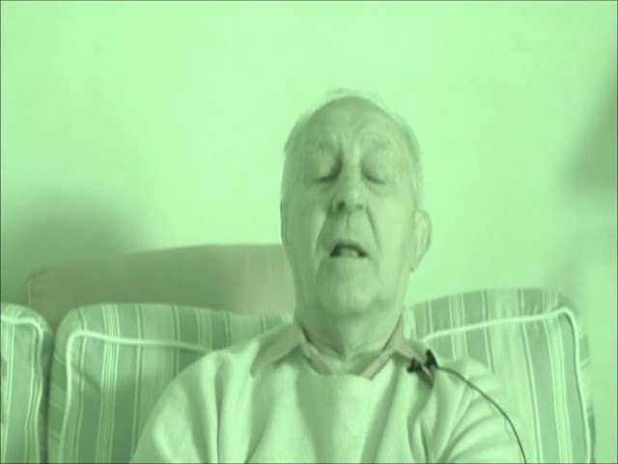
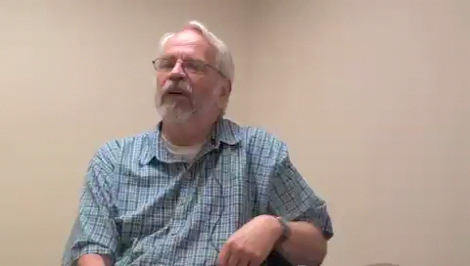
Know your equipment, and do your test/check!

Slide 12
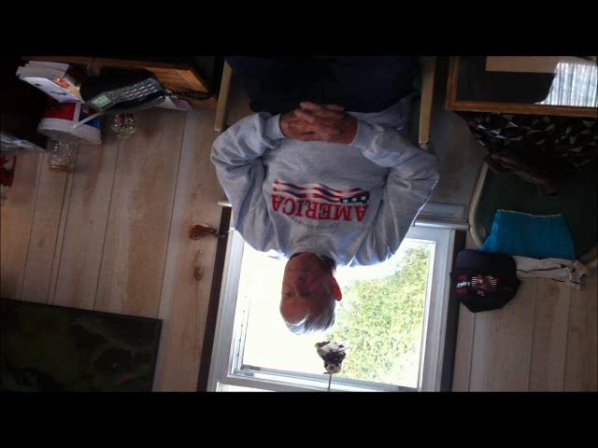
Know your equipment, and do your test/check!
(Also an example of a family member in the interview)

Slide 13
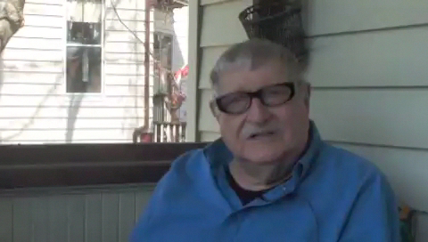
Location, Location, Location!

Slide 14
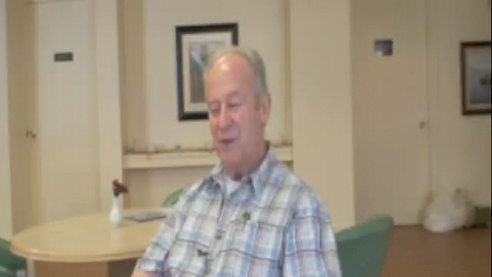
Avoid public spaces, there may be distractions or interruptions.

Slide 15
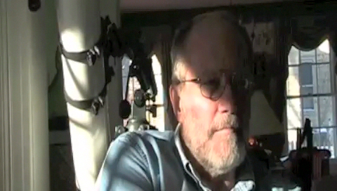
As you set up, be mindful of light, windows, mirrors, etc. The veteran should be comfortable from the start and not have to adjust partway through.

Slide 16
GO TO PART 2….

